Slide 1

Varendra University
Dept. of Computer Science & Engineering (CSE)
Discussion of CO, PO, K,P,A
Course Title: Microprocessor and Assembly Language
Course No: CSE 3205
Prepared By:
Md. Adnan Sami
Lecturer, Dept. of CSE, VU

Slide 2
Outline
Overview.
Learning Outcomes (Theory).
Program Outcomes (POs).
Knowledge and Attitude Profile.
Complex Engineering Problems.
Complex Engineering Activities.
Assessment Tools (Theory).
Learning Outcomes (Lab).
Assessment Tools (Lab).
Presentation’s Evaluation.

Slide 3
Overview
Course Title: Microprocessor and Assembly Language
Course Code: CSE 3205
Course Type: Theory
Credits: 3
Prerequisite Knowledge: Computer Architecture
Year and Semester: 3rd Year, Summer Semester, 2026

Slide 4
Learning Outcomes (Theory)
COs | Description | Taxonomy domain/level | POs | WK | WP | EA | Teaching-Learning strategy | Assessment strategy
CO1 | Describe Intel 8086 microprocessor Organization and Instruction sets | Cognitive/ Understand | 1 | 4 |  |  | Lecture/Slides | Mid Term
CO2 | Apply flow control, shift, and rotation instructions to develop efficient program logic. | Cognitive/ Apply | 2 | 4 |  |  | Lecture/Slides | Class Test
CO3 | Use memory addressing modes for efficient data access | Cognitive/ Apply | 3 | 5 |  |  | Lecture/Slides | Final

Slide 5
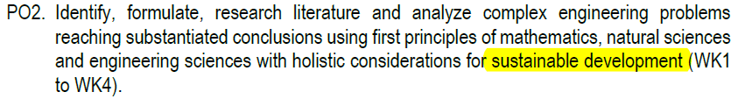
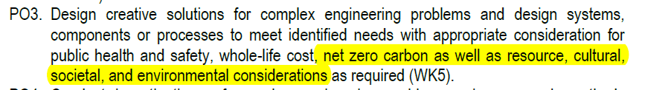
Program Outcomes (POs)

Slide 6
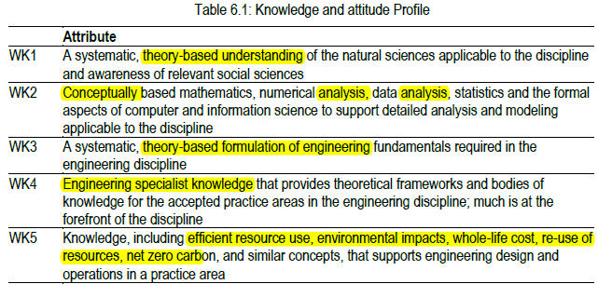
Knowledge and Attitude Profile

Slide 7
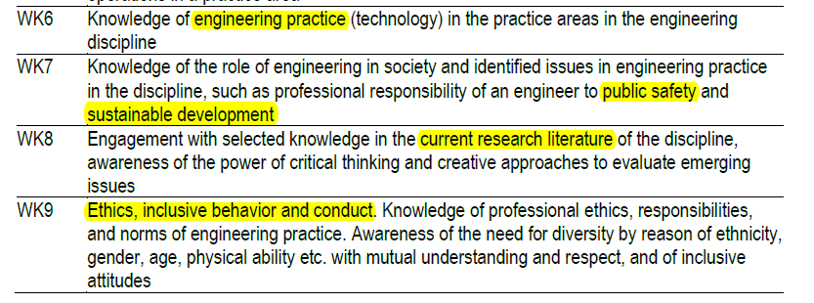
Knowledge and Attitude Profile

Slide 8
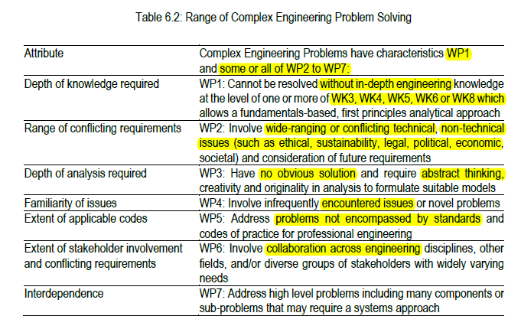
Complex Engineering Problems

Slide 9
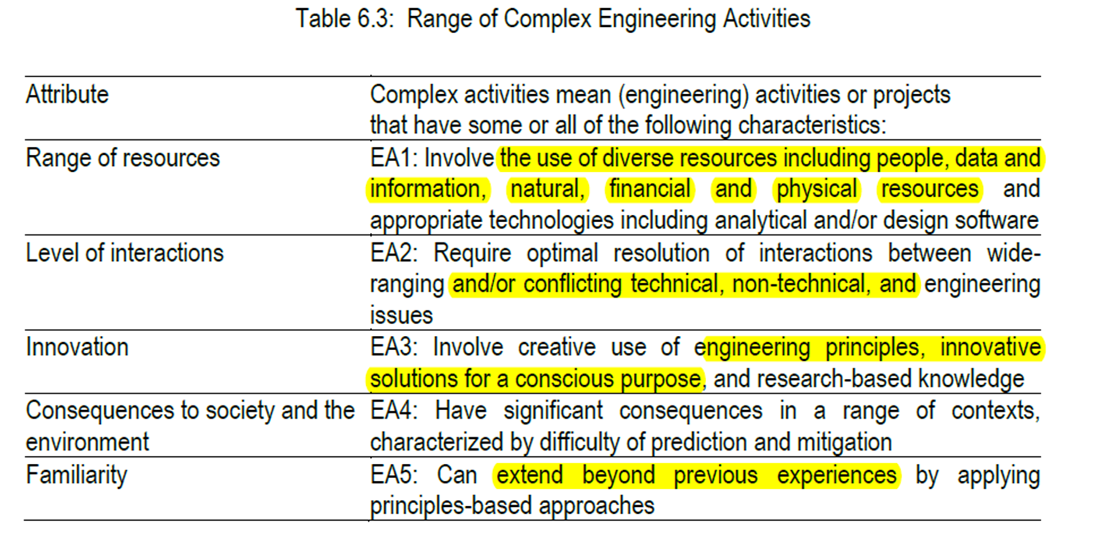
Complex Engineering Activities

Slide 10
Assessment Tools (Theory)
 | Assessment Tools | Marks (%)
Continuous Assessment (CA) | Class Participation | 10% | 40%
 | Class Test, Assignment, Project, Discussion, Presentation | 30%
Summative Assessment (SA) | Mid-term Examination | 24% | 60%
 | Final Examination | 36%
Total |  |  | 100%

Slide 11
Learning Outcomes (Lab)
COs | Description | Taxonomy domain/level | POs | WK | WP | EA | Assessment strategy
CO1 | Demonstrate basic input/output operations with 8086 microprocessors. | Cognitive/ Apply | 1 | 3 |  |  | Lab Test
CO2 | Solve problems using decision-making and logical operation instructions | Cognitive/ Apply | 2 | 4 |  |  | Lab Test

Slide 12
Assessment Tools (Lab)
Assessment Tools | Marks (%)
Class Participation | 10%
Continuous Assessment (CA) | 40%
Lab Final | 50%
Total | 100%

Slide 13
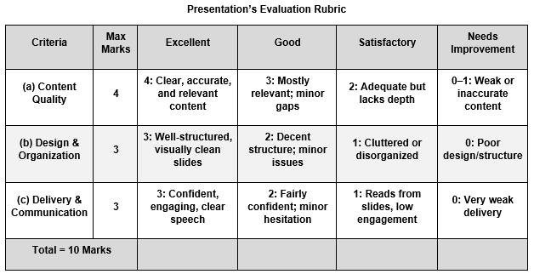
Presentation’s Evaluation (Mandatory)

Slide 14
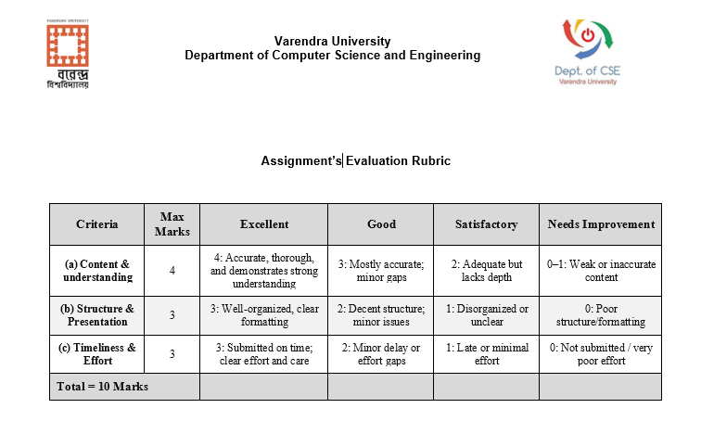
Presentation’s Evaluation (Optional)

